Slide 1

Cancellations
By Johnny Thephavong - jthep824@gmail.com

Slide 2
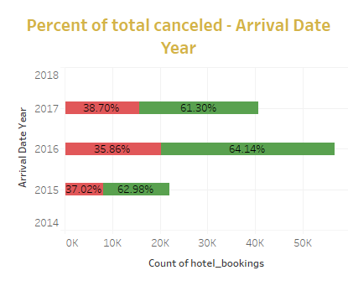
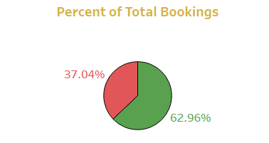
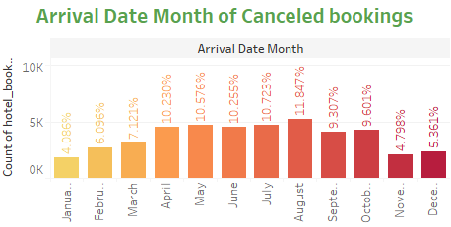

How can the Portuguese hotels optimize bookings and reduce the number of potential cancellations by 8% for the next fiscal year through determining significant factors that allude to cancellations and developing a predictive model to implement efficient marketing strategies ?
-Total canceled bookings make up about 37% of total bookings from 2015-2017.
-In 2016, booking numbers more than doubled the amount of 2015, however the number of canceled bookings also more than doubled.
-In 2017, The Hotel saw a decrease in business of around 10%, however canceled bookings decreased only around 4%.
-There seems to be a notion of seasonality where canceled bookings seem to be consistently higher between the months of April and August.
-It would benefit the Hotel to be proactive in its marketing strategies to prevent further extreme changes in booking cancellations.

Slide 3
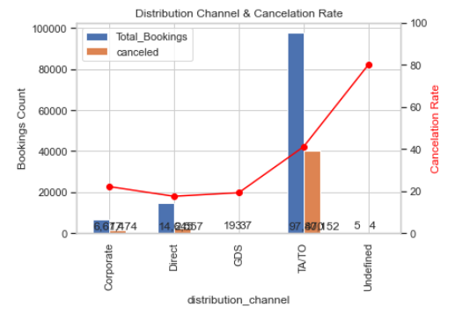
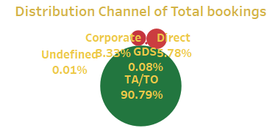
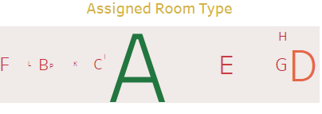
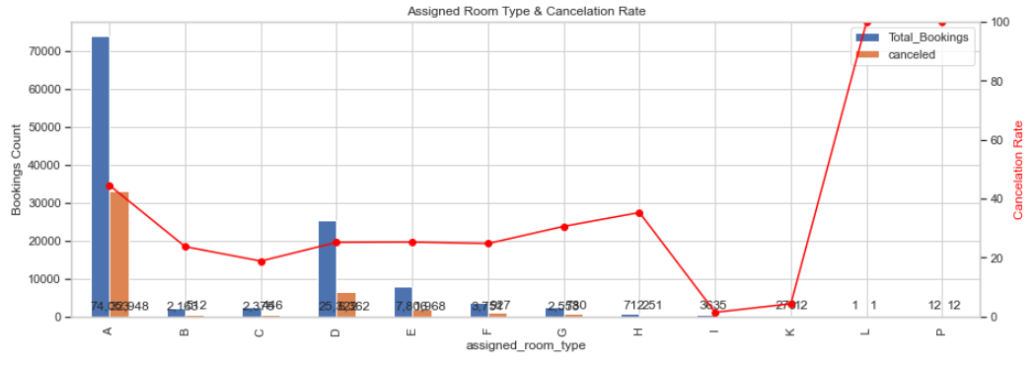
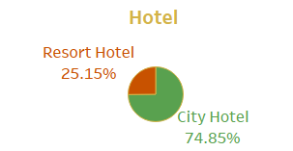
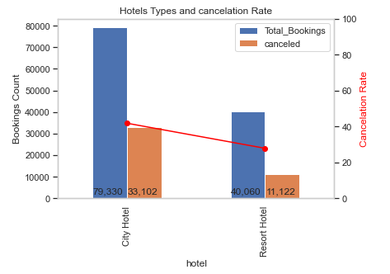
A predictive logistic regression model is proposed to reduce stresses on the limited marketing budget appointed to relieve issues of booking cancellations. Significant categorical determining variables need to be extracted from the data using Weight of Evidence and Information Value.
Travel agency/tour operators and Direct channels of distribution make up over 96% of the total canceled bookings with TA\TO having a significantly higher rate of cancellation.
According to IV and WOE, its IV of 0.156327 makes distribution channel a significant variable that is a good predictor
The Assigned Room Type variable has an IV score of 0.200107 which is considers it to be a significant predictor.
With the assigned room types, A, D, E making up 89.78% of total canceled bookings, it would be at the hotel's best interest to consider a type of discount marketing strategy that involves retaining consumers of these room types.
According to IV tests, the hotel variable has a score of 0.083066 which makes it significant in predicting cancellation.
City hotels make up 74.85% of the canceled bookings. This is a significant proportion for the hotel to consider allocating marketing efforts towards the city sector.

Slide 4
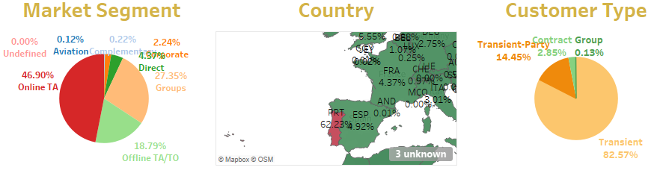
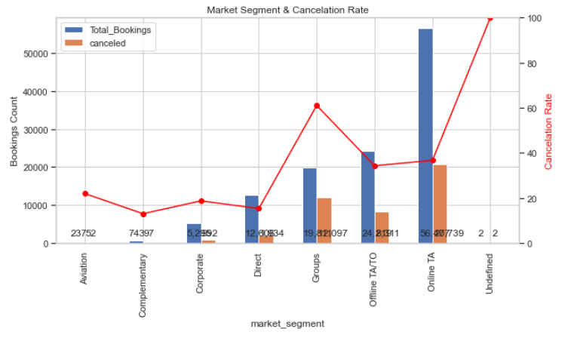
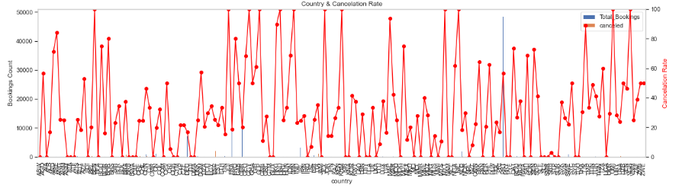
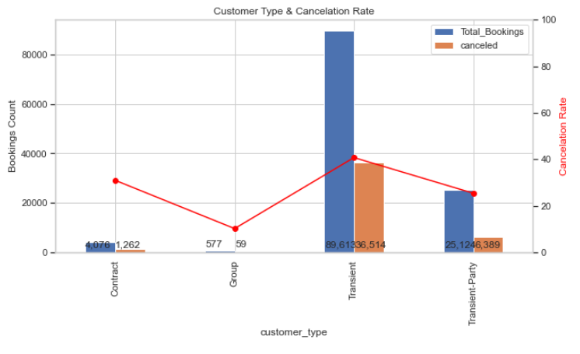
Some categorical variables need to be broken down into parts of significant data. The Market Segment, Country, & Customer Type variables need to be dissected into useful information in order to optimize the Logistic Regression model. -The Market Segment with an IV of 0.328541 is a good predictor. About 93% of canceled bookings are within these three segments: Online TA, Offline TA/TO, Groups -The Country variable has an IV of 0.589854. About 73% of the canceled bookings fall between 3 countries : PRT,GBR,ESP - The Customer Type variable has an IV of 0.087284. About 99% of the canceled bookings are in the Transient,Transient_Party, and Contract types

Slide 5
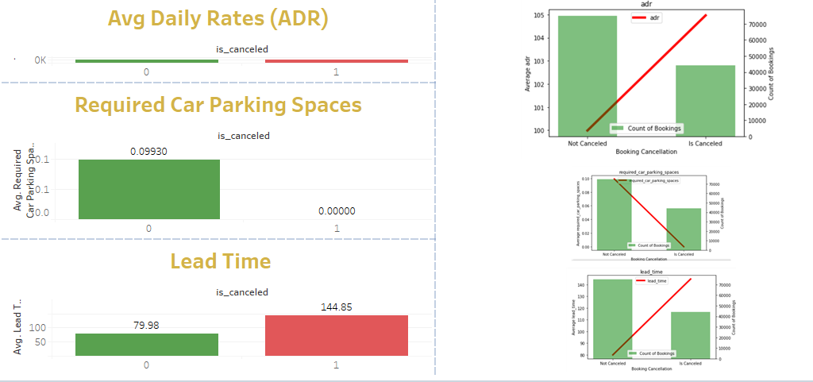
In order to have a more efficient model, we must include significant continuous variables that can be established through conducting z-tests to evaluate the p-values. Variables with P-values less than 0.05 are considered significant. -ADR - 2.8041 e-05 \Required Car Parking Spaces - 0.0004 \ Lead time - 5.92e-213

Slide 6
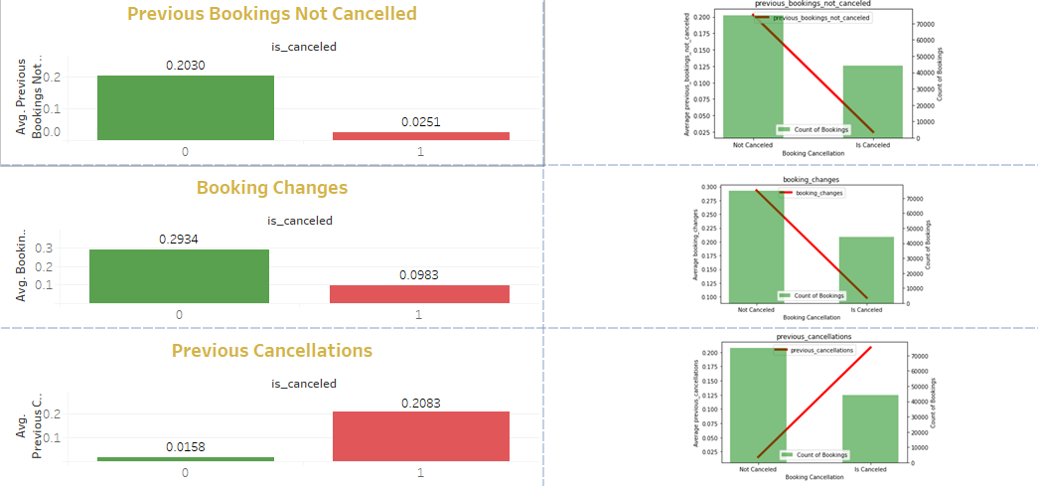
We continue to evaluate the continuous variables of the data with z-tests. -P-values - Previous Bookings Not Canceled - 0.0024 \ Booking Changes - 0.0091 \ Previous Cancellations - 0.0006

Slide 7
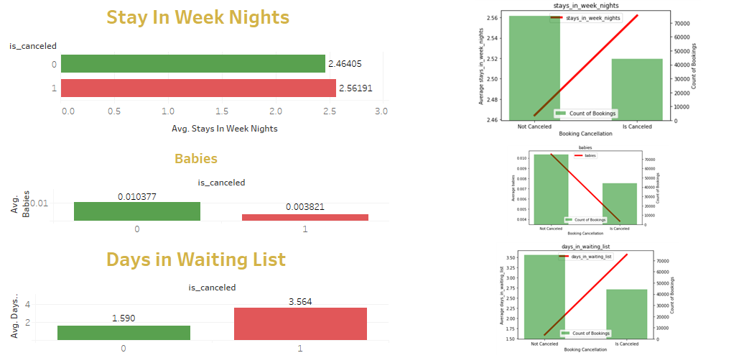
After Evaluating all the continuous variables with z-tests, we have established an optimal number of variables to consider for our prediction model. p-values - Stays in Week Nights - 0.022 \ Babies - 0.0001 \ Days in Waiting List - 0.0013

Slide 8
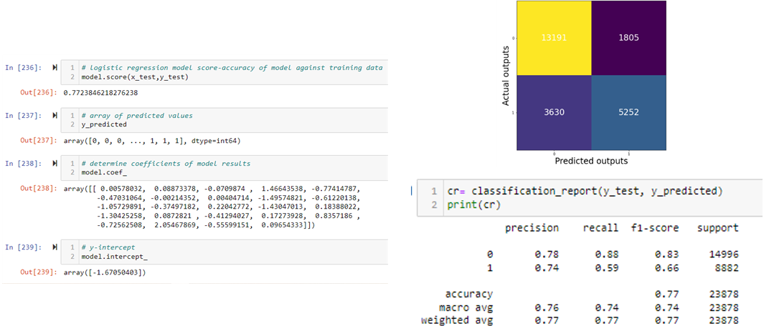
After running the logistic regression model, we have established a score of 0.77 which means our model is a good predictor of canceled outcomes.

Slide 9
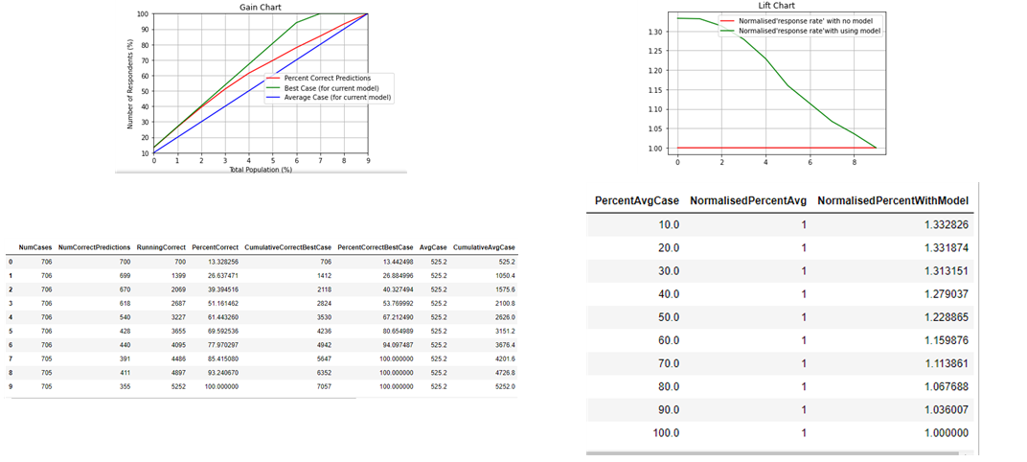
After running the model, we validate it with a gains chart and lift chart. The gains chart tells us, for example that we can expect to capture 40% of the canceled bookings by targeting the top 20% of the hotel guests.

Slide 10
Insights
It would benefit the Hotel to have a continued proactive approach in its marketing strategies targeting the summer months when cancellations are at their highest.
The distribution channel TA/TO accounts for over 90% of the cancellations. The Hotel should establish a better relationship with the TA/TO's and develop a plan to give them incentive to combat cancellations.
Assigned_room_types A, D, and E make up almost 90% of cancellations. It is suggested that the hotel offer these rooms at a discounted rate to entice consumers to stay.
It is highly suggested that the hotels marketing team establish a strategy incorporating all of the variables involved in the regression model in order to optimize efforts and reduce cost to the limited budget.

